Slide 1

Classification of Cervical Cancer Cells Through Visual Transformers
Presented by:
Thomas Fiello II
Mariah Marin
Wairimu Mwangi
Marcelo Ruiz Leon, Sr.
Alexis Smith
Notes:
Alexis

Slide 2

OVERVIEW
Introduction
Background
Methodology
Results
Conclusion
Future Work
References
Notes:
Alexis

Slide 3
INTRODUCTION
Notes:
Alexis

Slide 4
Motivation
Vision Machine Learning
Biological Classifications and Applications
Notes:
Alexis

Slide 5
VISION MACHINE Learning
Artificial Intelligence
Machine Learning
Vision Machine Learning
The goal of Vision Machine Learning is for computers to "see" and understand the world in the same way that we do.
Notes:
Alexis
Computer vision is the automated extraction of information from images.
camera position, object detection and recognition to the classification purposes we are using it for

Slide 6
Biological Applications
Enhance ability to identify health problems using technology
Create a program that can be used by medical professionals to assist in the process
Revolutionize the way health screenings are conducted
Notes:
Alexis
ability to identify health problems using technology

Slide 7
Advancements in Biological applications
Historically machine learning in biological settings has been restricted by lack of data.
However, we can now produce accurate and deployable models with less data sets.
Notes:
Alexis

Slide 8
DATASET selection and BACKGROUND
Notes:
Marcelo

Slide 9

Dataset selection
Malaria Data Sets
Over 27.5k samples
Internationally used dataset from the National Institute of Health
Cervical Cancer Data Sets
No single recommended database
Largest single database is just over 5k samples
Better representation of the average small medical dataset.
Notes:
Marcelo
Accurate and deployable models with less data sets

Slide 10
Sipakmed Dataset
966 cluster cell images of Pap smear slides, 4049 images of isolated cells manually cropped
Images acquired through charged-coupled device (CCD) camera adapted to an optical microscope
Cell images divided into 5 categories:
Superficial-Intermediate
Parabasal
Koilocytotic
Dyskeratotic
Metaplastic
Herlev Dataset
Contains 917 images of single cells.
The morphological features (i.e., cell shape, nucleus size, nucleus to cytoplasm ratio, nucleus opacities, nucleus dying intensities, cytoplasm opacities, and cytoplasm dying intensities) help differentiate the cells.
It was created utilizing a digital camera microscope
Cell Images divided in 7 classes:
Superficial Squamous Epithelia
Intermediate Squamous Epithelia
Columnar Epithelial
Mild Squamous Non-Keratinizing Dysplasia,
Moderate Squamous Non-Keratinizing Dysplasia,
Severe Squamous Non-Keratinizing Dysplasia
Squamous Cell Carcinoma
Notes:
Marcelo

Slide 11
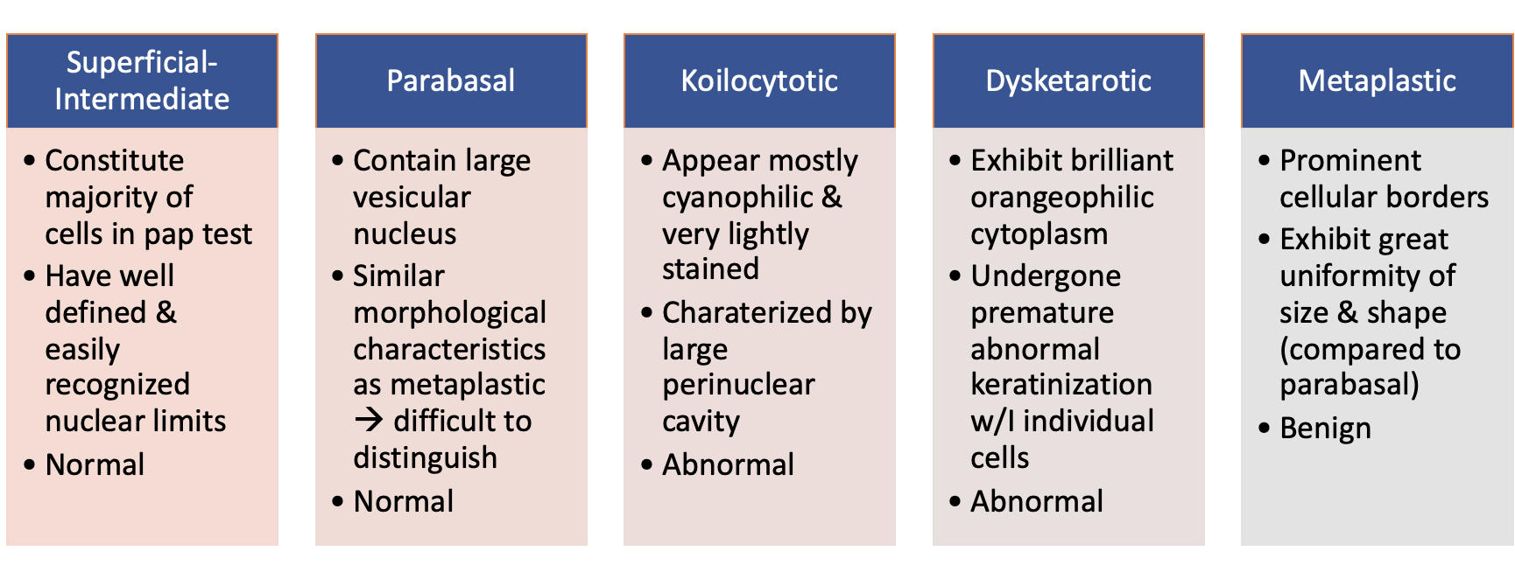
Sipakmed database Classes
Notes:
Marcelo

Slide 12
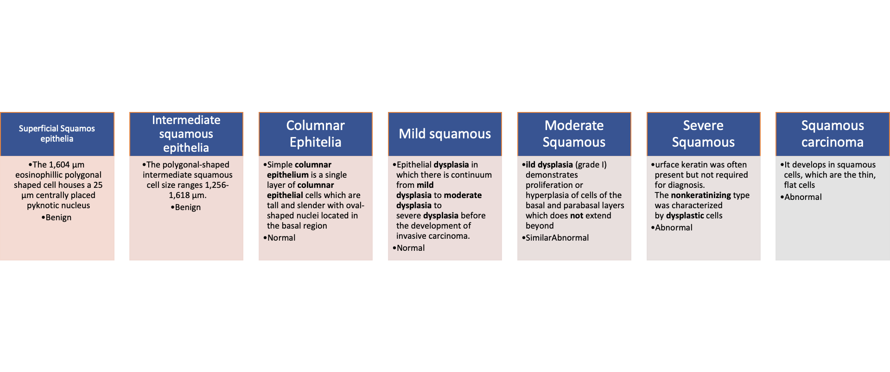
HERLEV database Classes
Notes:
Marcelo

Slide 13
Vision Transformers
Notes:
Wairimu

Slide 14
TimeLine of vision transformers (Vit)
2017
"Attention is All You Need" proposes the "transformer"
2021
"An Image is Worth 16x16 Words" takes the base transformer and applies it to computer vision
2021
Team 5 uses information from these papers to create a transformer to identify cervical cell cancer
"Training Compact Transformers from Scratch in 30 Minutes with PyTorch"
2022
Notes:
Wairimu
Attention is all you need proposed the transformer, using the attention mechanism

Slide 15
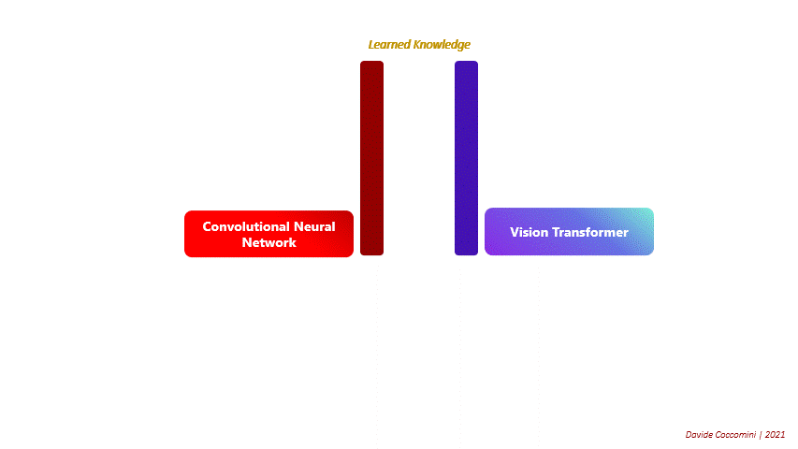
Transformers vs CNNs
Pros
CNNs
Well tested with lots of research.
Can learn more on less data than Transformers.
Transformers
Lacks inductive bias.
Capable of learning more than CNNs with enough data.
Cons
CNNs
High bias.
Computationally Expensive.
Transformers
High variance.
Requires large amounts of data to reach SOA performance.
Notes:
Wairimu

Slide 16
So Why Transformers?
Current state-of-the art model and machine-learning trend.
Has a lot of untapped potential for greater performance.
To show that with simple modifications, they can achieve high accuracies on smaller datasets.
Notes:
Wairimu

Slide 17

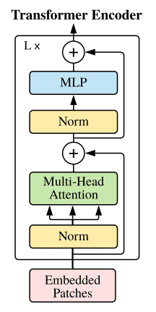
STANDARD TRANSFORMER ARCHITECTURE
https://arxiv.org/abs/2010.11929 https://theaisummer.com/vision-transformer/
Notes:
Wairimu

Slide 18
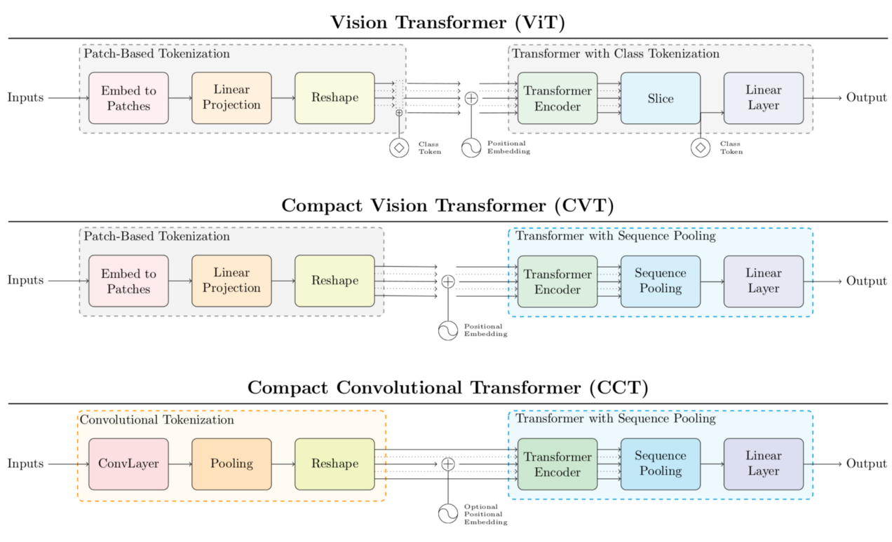
https://theaisummer.com/vision-transformer/
Notes:
Wairimu

Slide 19
METHODOLOGY
Notes:
Wairimu

Slide 20
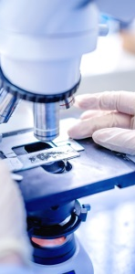
overview
Built a custom Visual Transformer (ViT)
Compact Convolutional Transformer (CCT)
Current ViTs outperform CNNs which were previously used in image recognition – inductive bias
Goal – classify images of cervical cancer cells obtained from a microscope by sorting them in their respective cell categories
Notes:
Wairimu

Slide 21
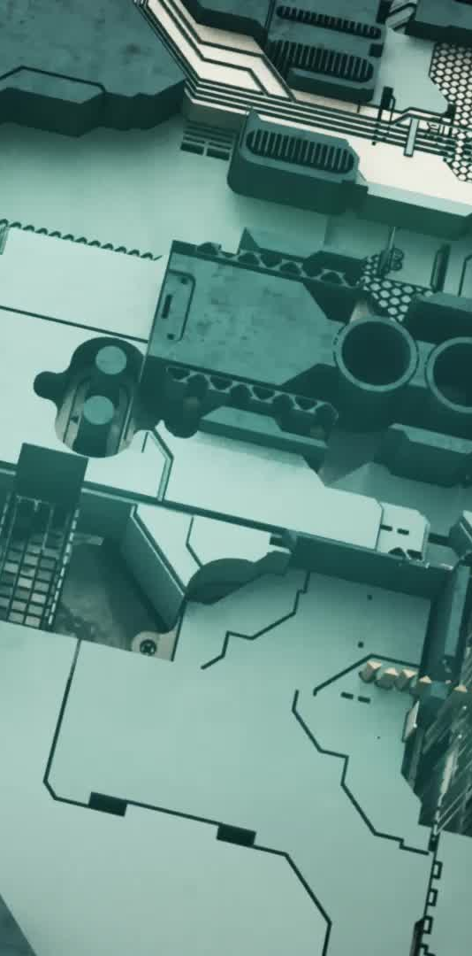
APPROACH
Comparison/differences between a Standard Transformer and a Compact Convolutional Transformer (CCT):
Basic requires a large training dataset while CCT accommodates smaller training sets
Basic embeds class tokens as a separate layer while CCT uses sequence pulling
Basic model has high variance and CCT introduces bias via a convolutional layer
PyTorch was used to build the ViT layers
Notes:
Wairimu

Slide 22
Preface to model creation
Using PyTorch/Timms could have loaded built-in models
Instead built transformer from scratch to understand how they work and how to maximize flexibility
Custom PyTorch dataset class created
Provides more flexibility with data
Program running options
CPU on a regular laptop – need to reduce epochs
Thomas' computer with GPU – allowed faster model training and run more epochs
Notes:
Wairimu

Slide 23
Building the Transformer
Built original 16x16 ViT
From 'An Image is Worth 16x16 Words' paper
Compact ViT (CVT) Stage
Followed 'Training Compact Transformers...' paper
Sequence pooling layer
Ties class information in with every other parameter vs. embedding classes separately to pass to MLP for classification.
Compact Convolutional Transformer (CCT) Stage
Replaced patching layer with convolutional layer
Eliminates issue of creating bordered segments. Reduces variance through convolutional bias.
Additional modifications performed later:
Convolutional layers made iterable as a hyperparameter.
Normalized convolutional layer weights
Notes:
Mariah

Slide 24
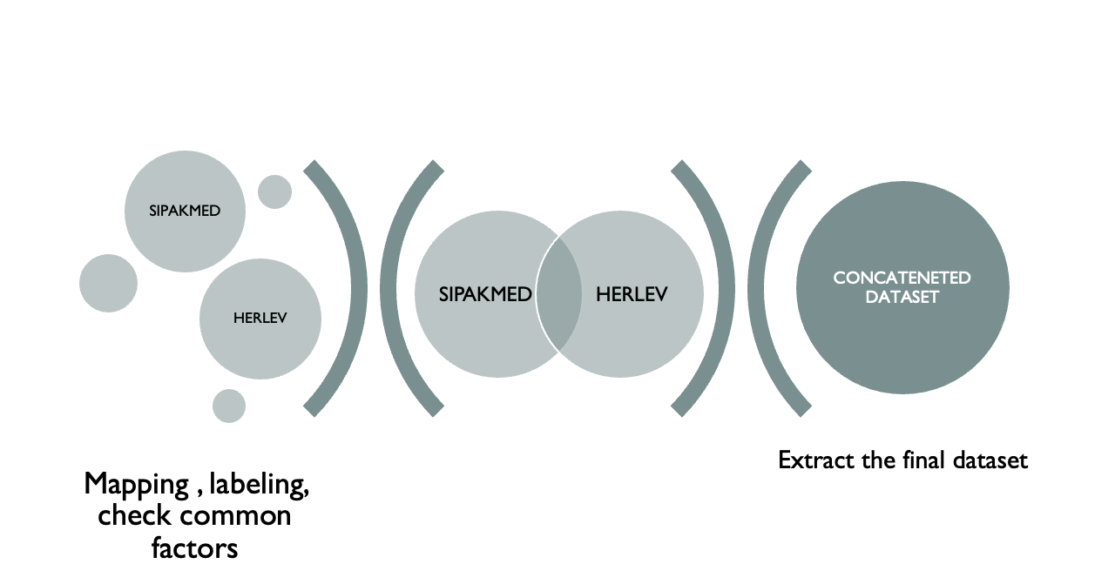

Data pre-processing
Notes:
Mariah

Slide 25
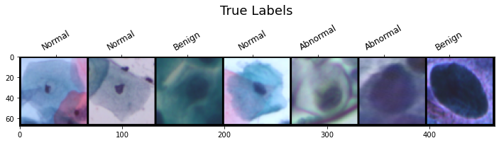
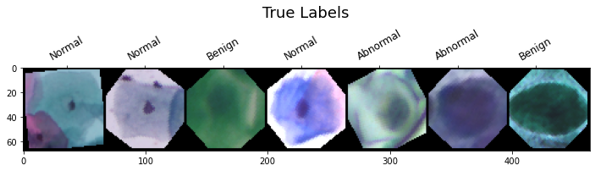
Data augmentation
Original Input Samples:
Original datasets very small compared to usual input for a transformer
An important factor in the original transformer's performance because they are prone to overfitting.
In-place data augmentation implemented
Images fed as training input to model with various likelihoods of applying random augmentations, such as: rotations, horizontal flips, brightness, and hue changes.
Augmented Input Samples:
Notes:
Mariah

Slide 26
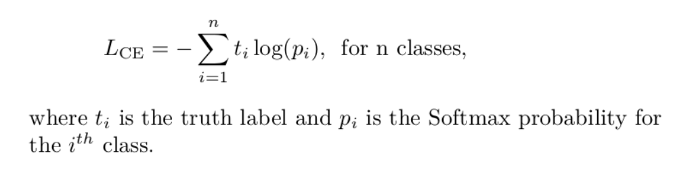
Hyper-parameter selection
Cross entropy loss
Utilized when adjusting model weights during training.
Aims to minimize loss in each iteration – model is 'learning'.
Equation:
Calculating testing accuracy
Dividing total correct predictions by total overall predictions.
Note:
1- accuracy = error is valid
But produces different value than cross entropy loss because different methods.
Notes:
Mariah

Slide 27
MODEL HYPER-PARAMETERS AND attributes
Hyper-parameters
Image Size
Number of Input Channels
Patch Size
Embedding Size
Number of Transformer Blocks
Number of Attention Heads
Dropout Probability
MLP Ratio
Bias
Number of Classes
Attributes
Number of Patches
Patching Layer Embedding
Class Embedding
Positional Embedding
Dropout Layer
Encoder Layer
Layer Normalization
Notes:
Mariah

Slide 28
Model application to higher classification problems
Originally applied to 3 concatenated classes (benign, abnormal, normal)
Split: 70% training, 15% validation, 15% testing
3584 training, 768 validation, 768 testing
Once 'best' results obtained, model with same settings applied to:
5 class SIPaKMeD dataset (parabasal, metaplastic, etc.)
Split: 70% training, 15% validation, 15% testing
2944 training, 640 validation, 640 testing
7 class Herlev dataset
Split: 60% training, 20% validation, 20% testing
640 training, 256 validation, 256 testing
Notes:
Mariah

Slide 29
Optimizing Hyper-Parameters
The first step was optimizing the hyper-parameters, which could only really be done by testing the model repeatedly with slight adjustments - Extremely time consuming
Some values were easy to dial-in by just adding or subtracting a single value until the accuracy stopped increasing:
Patch size, number of encoder layers, number of attention heads, MLP ratio, etc.
Other values had to be balanced with computational resources in mind.
Training on the GPU is exponentially faster but limited to 4gb of memory.
Batch size, image size, and embedding dimensions all had to be carefully balanced to give the best performance while not going over the allocated amount of memory.
Notes:
Mariah

Slide 30
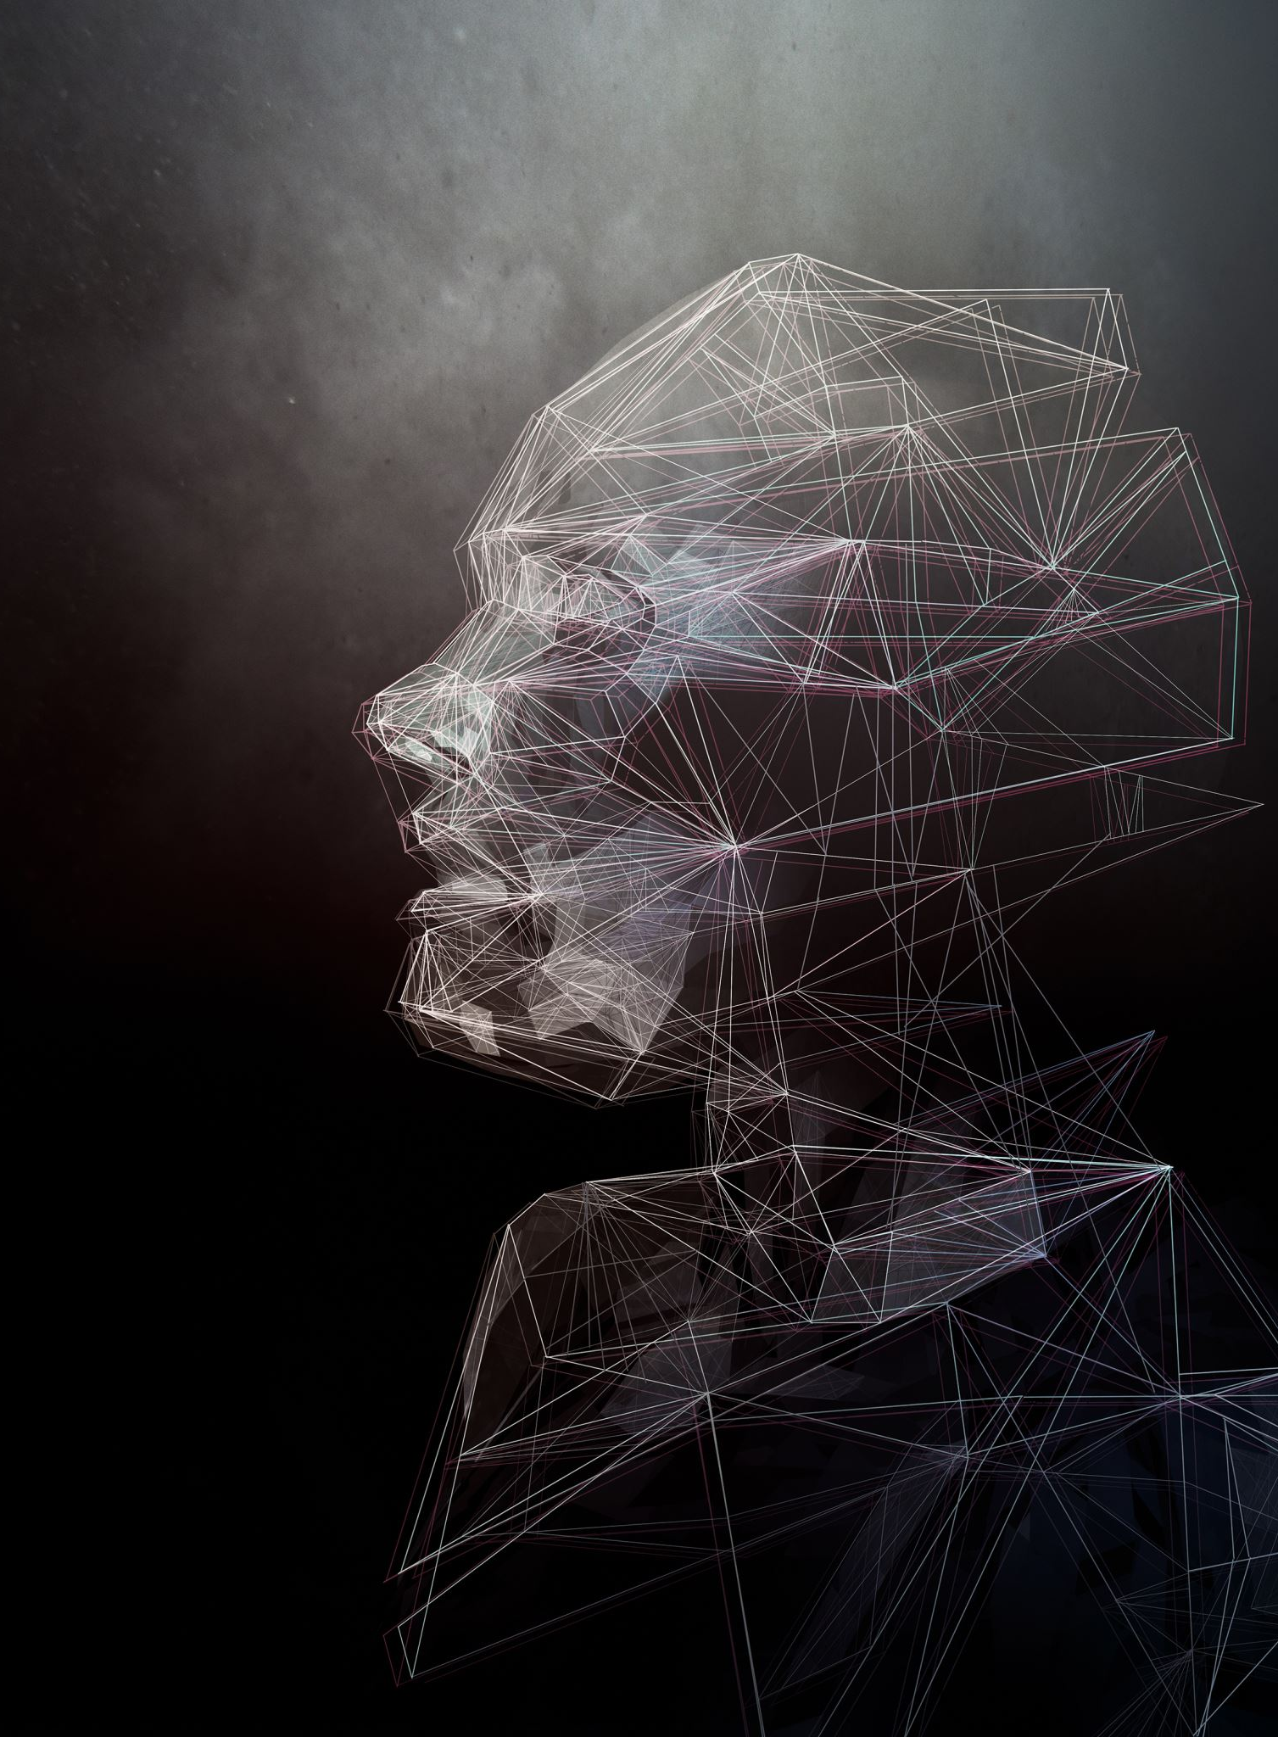
The Optimized hyper-parameters and final setup
Image Size: 64x64 pixels
Batch Size: 128
Patch Size: 4
Embedding Dimensions: 128
Encoder Layers: 2
Attention Heads:2
MLP Ratio: 1
Initial Epoch Number: 100
random_state=1
torch.manual_seed(17)
Notes:
Mariah

Slide 31
The base model
After finding the "best" settings for the model, we decided to train the data on the original 16x16 Vision Transformer first, that way we would have a "base model" to measure the CCT's performance from.
Notes:
Mariah

Slide 32
Results
Notes:
Thomas

Slide 33
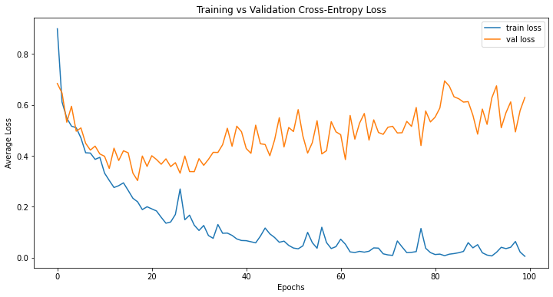
Base Results
Accuracy/Error:
Average Test Accuracy: 90.82%
Average Test Loss: 0.5089
Computational Resources:
Average Epoch Duration: 7.68s
Total Training Time: 12m48.1s
GPU Memory Usage: 3.1GB

Slide 34
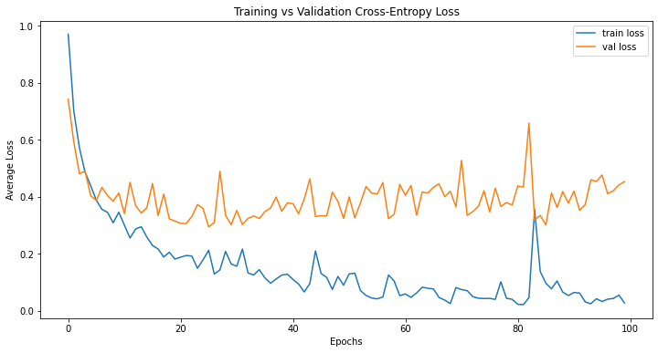
CCT-1 Results
Accuracy/Error:
Average Test Accuracy: 88.47%
Average Test Loss: 0.4516
Computational Resources:
Average Epoch Duration: 9.22s
Total Training Time: 15m22.2s
GPU Memory Usage: 3.4GB

Slide 35
Base vs cct-1
Accuracy/Error:
Avg Test Accuracy: 90.82% vs 88.47%
Avg Test Loss: 0.5089 vs 0.4516
Computational Resources:
Avg Epoch Duration: 7.68s vs 9.22s
Total Training Time: 12m48.1s vs 15m22.2s
GPU Memory Usage: 3.1GB vs 3.4GB

Slide 36
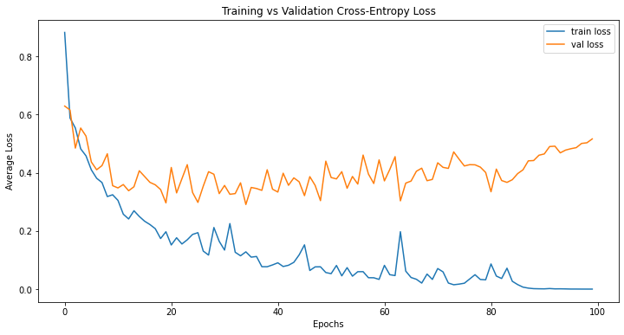
CCT-2 Results
Accuracy/Error:
Average Test Accuracy: 92.26%
Average Test Loss: 0.5067
Computational Resources:
Average Epoch Duration: 9.06s
Total Training Time: 15m5.7s
GPU Memory Usage: 3.4GB

Slide 37
cct-1
cct-2

Slide 38
Base vs cct-2
Accuracy/Error:
Avg Test Accuracy: 90.82% vs 92.26%
Avg Test Loss: 0.5089 vs 0.5067
Computational Resources:
Avg Epoch Duration: 7.68s vs 9.06s
Total Training Time: 12m48.1s vs 15m5.7s
GPU Memory Usage: 3.1GB vs 3.4GB

Slide 39
Introducing: Augmentations
Measurements | Base Model | CCT-2 | + Random Horizontal Flips (75%) | + Random Rotation (60°) | + ColorJitter (Brightness and Hue: 20%)
Avg Accuracy | 90.82 | 92.26 | 93.14 | 94.37 | 94.66
Avg Loss | 0.5089 | 0.5067 | 0.3304 | 0.1755 | 0.1597
Avg Epoch Duration (s) | 7.68 | 9.06 | 9.94 | 10.50 | 11.79
Total Train Time (HH:MM:SS) | 00:12:48 | 00:15:06 | 00:16:34 | 00:17:31 | 00:19:40
GPU Memory (GB) | 3.1 | 3.4 | 3.5 | 3.5 | 3.6

Slide 40
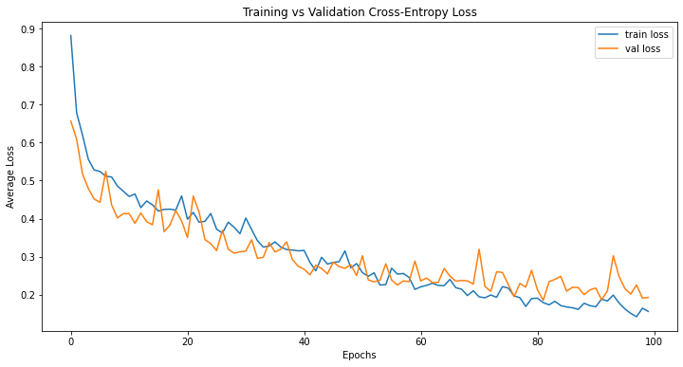
CCT-2 Plus 3 augments (CCT-2.3)
Accuracy/Error:
Average Test Accuracy: 94.66%
Average Test Loss: 0.1597
Computational Resources:
Average Epoch Duration: 11.79s
Total Training Time: 19m39.8s
GPU Memory Usage: 3.6GB

Slide 41
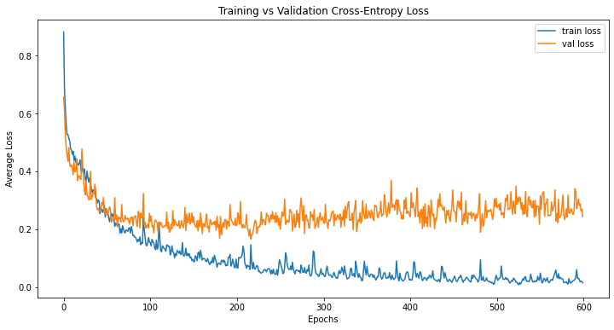
Expanding the training
Measurements | Base Model | CCT-2.3 100 Epoch | CCT-2.3 600 Epoch
Avg Accuracy | 90.82 | 94.66 | 96.22
Avg Loss | 0.5089 | 0.1597 | 0.2107
Avg Epoch Duration (s) | 7.68 | 11.79 | 10.89
Total Train Time (HH:MM:SS) | 00:12:48 | 00:19:40 | 01:48:54
GPU Memory (GB) | 3.1 | 3.6 | 3.6

Slide 42
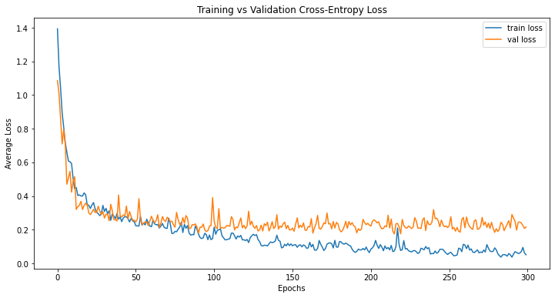
CCT-2.3 5-class sipakmed dataset 300 epochs
Accuracy/Error:
Average Test Accuracy: 95.59%
Average Test Loss: 0.1567
Computational Resources:
Average Epoch Duration: 17.35s
Total Training Time: 86m46.5s
GPU Memory Usage: 3.7GB

Slide 43
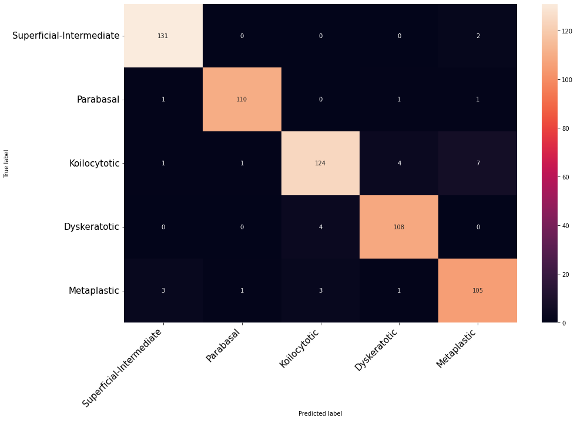
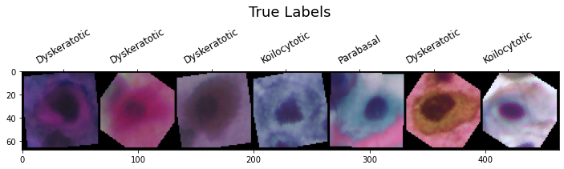
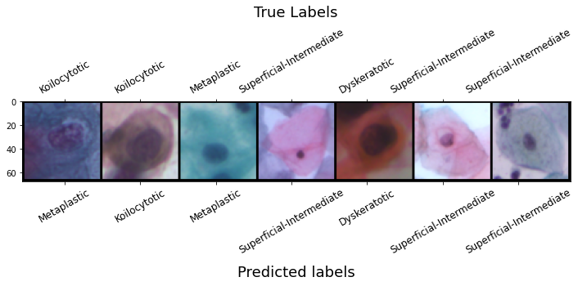

Slide 44
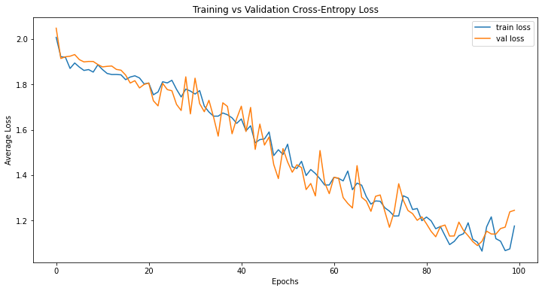
CCT-2.3 7-class Herlev dataset 100 epochs
Accuracy/Error:
Average Test Accuracy: 58.49%
Average Test Loss: 1.2077
Computational Resources:
Average Epoch Duration: 1.99s
Total Training Time: 3m19.2s
GPU Memory Usage: 3.6GB

Slide 45
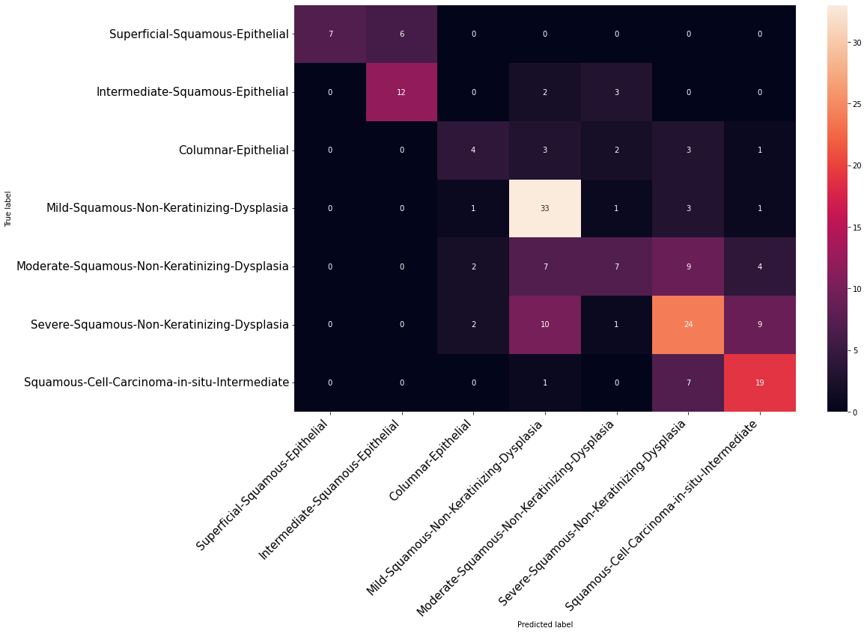
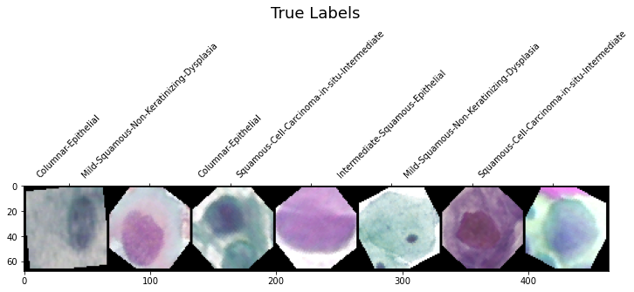
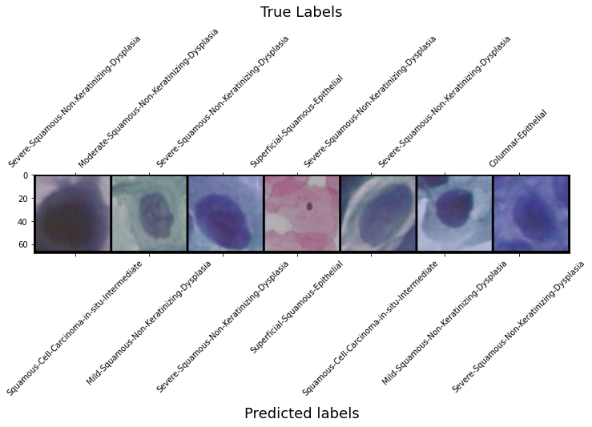

Slide 46
Conclusion
Notes:
Thomas

Slide 47
Measurements | Concatenated | Concatenated | Sipakmed | Herlev
Model | Base | CCT-2.3 | CCT-2.3 | CCT-2.3
Epochs | 100 | 600 | 300 | 100
Classes | 3 | 3 | 5 | 7
Samples | 5120 | 5120 | 4224 | 1152
Avg Accuracy | 90.82 | 96.22 | 95.59 | 58.49
Avg Loss | 0.5089 | 0.1597 | 0.1567 | 1.2077

Slide 48
The Take away
Compact Convolutional Transformers and in-place Data Augmentation do a lot to improve performance on smaller datasets, but it is still not enough to produce accurate results using datasets under 1000 samples.

Slide 49
FUTURE WORK
Notes:
Thomas

Slide 50
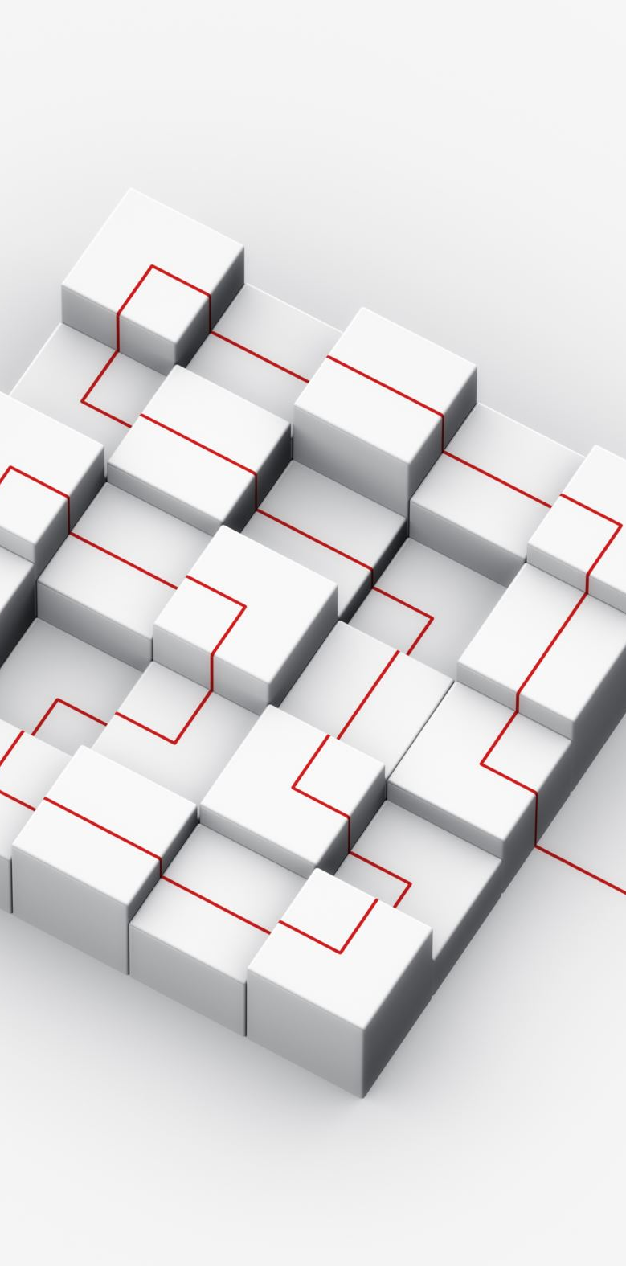
The next steps
Pre-processing versus in-place data augmentation.
Compare results to the professional Pytorch/Timms models.
Save model parameters between training sessions.
Possibly use GANs to build up smaller datasets.
Implement any new improvements which may have occurred.

Slide 51
REFERENCES
Vaswani, Ashish & Shazeer, Noam & Parmar, Niki & Uszkoreit, Jakob & Jones, Llion & Gomez, Aidan & Kaiser, Lukasz & Polosukhin, Illia, “Attention is all you need” , 2017.
Dosovitskiy, Alexey, et al. "An image is worth 16x16 words: Transformers for image recognition at scale." arXiv preprint arXiv:2010.11929 (2020).
“Papers with Code - ImageNet Benchmark (Image Classification),” Paperswithcode.com, 2021. https://paperswithcode.com/sota/image- classification-on-imagenet (accessed Feb. 10, 2022).
World, “Cervical cancer,” Who.int, Dec. 02, 2019. https://www.who.int/health-topics/cervical-cancer (accessed Feb. 13, 2022).
“Cervical Cancer Statistics | Key Facts About Cervical Cancer,” Cancer.org, 2022. https://www.cancer.org/cancer/cervical-cancer/about/key-statistics.html (accessed Feb. 13, 2022).
Marina E. Plissiti, Panagiotis Dimitrakopoulos, Gior-gos Sfikas, Christophoros Nikou, Olga Krikoni, AntoniaCharchanti, SIPAKMED: A new dataset for feature and im-age based classification of normal and pathological cervical cells in Pap smear images, IEEE International Conference onImage Processing (ICIP) 2018, Athens, Greece, 7-10 October2018.

Slide 52
References cont.
“SIPaKMeD,” Cs.uoi.gr, 2022. https://www.cs.uoi.gr/ marina/si-pakmed.html (accessed Feb. 13, 2022).
Cv2, “Cervical Cancer largest dataset (SipakMed),” Kaggle.com, 2018.
https://www.kaggle.com/prahladmehandiratta/cervical-cancer-largest-dataset-sipakmed (accessed Feb. 13, 2022).
“Downloads,” Aegean.gr, Jul. 23, 2008. http://mde-lab.aegean.gr/index.php/downloads (accessed Feb. 13, 2022).
Bhatt AR, Ganatra A, Kotecha K. Cervical cancer detection in pap smear whole slide images using convNet with transfer learning and progressive resizing. PeerJComputSci. 2021;7:e348. Published 2021 Feb 18. doi:10.7717/peerj-cs.348.
Manna, A., Kundu, R., Kaplun, D. et al. A fuzzy rank-based ensemble of CNN models for classification of cervical cytology. Sci Rep 11, 14538 (2021). https://doi.org/10.1038/s41598-021-93783-8. Adaloglou, N. (2021, January 28).
How the vision transformer (VIT) works in 10 minutes: An image is worth 16x16 words. AI Summer. Retrieved from https://theaisummer.com/vision-transformer/
Pytorch. PyTorch. (n.d.). Retrieved from https://pytorch.org/

Slide 53

QUESTIONS

